Slide 1
GIT BRANCH

Slide 2
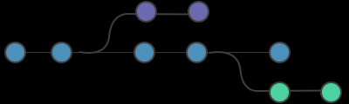
The git branch command creates, lists and deletes branches. It doesn’t allow switching between branches or putting a forked history back together again. Thus, git branch is integrated with the git checkout and git merge commands.

Slide 3
git branch Lists all of the branches in the repository (the same as git branch --list).
git branch <branch> Creates a new branch called <branch> but does not checks out the new branch.
git branch -d <branch> Deletes a branch. If there are unmerged changes, Git does not allow you to delete it.
git branch -D <branch> Forces delete the branch, even if there are unmerged changes. Execute this command when you are sure to delete it permanently.
git branch -m <branch> Moves or renames the current branch to <branch>.
git branch -a Lists all the remote branches.

Slide 4
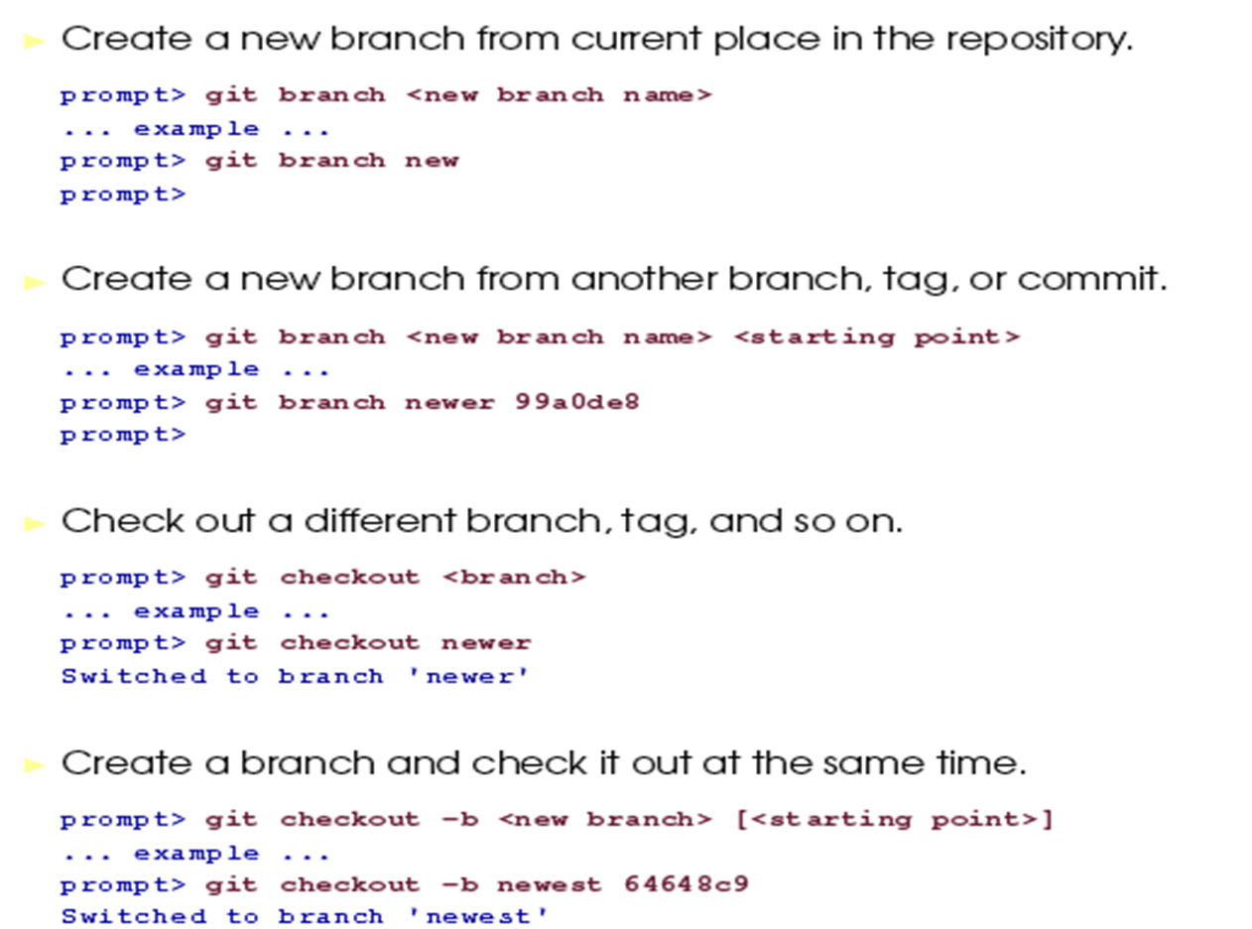

Slide 5
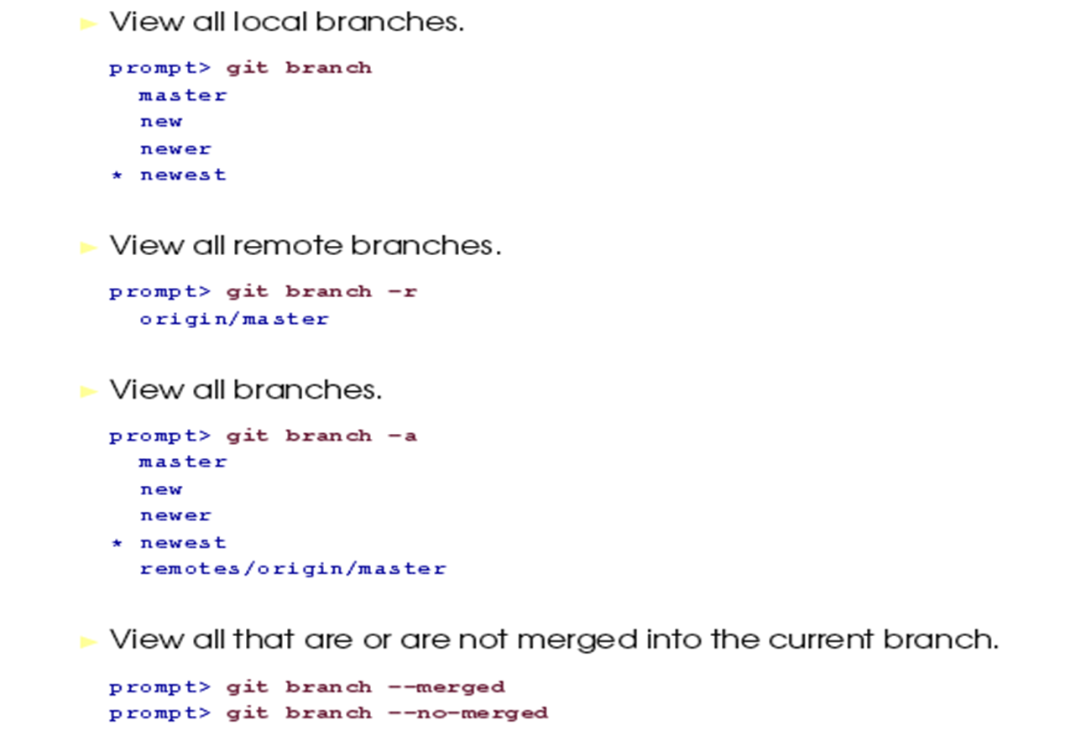

Slide 6
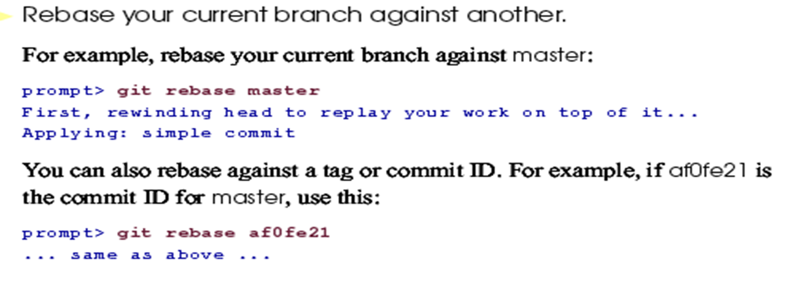

Slide 7
THANKYOU

